Slide 1
GPU Implementation of Equalization Algorithms
Jeff Ravert
Brigham Young University

Slide 2
Outline
Multipath
Project Introduction
Full System
My Key Contributions
MMSE
CMA
Results?
Solution-Current Work

Slide 3
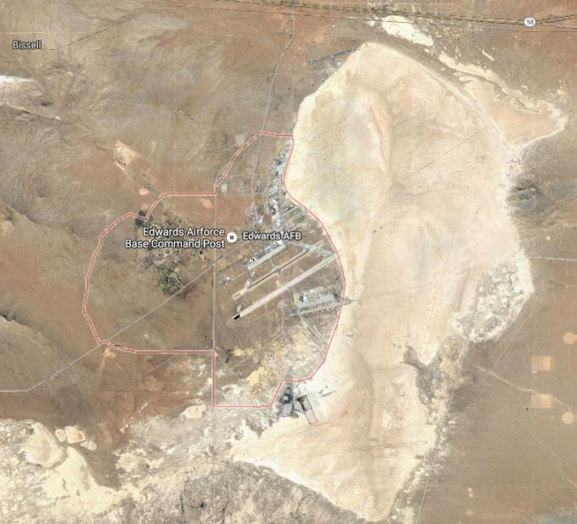
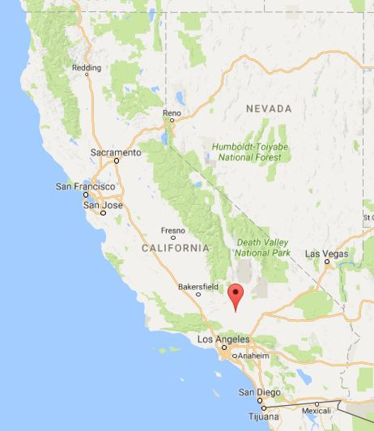
Multipath at Edwards AFB, CA

Slide 4
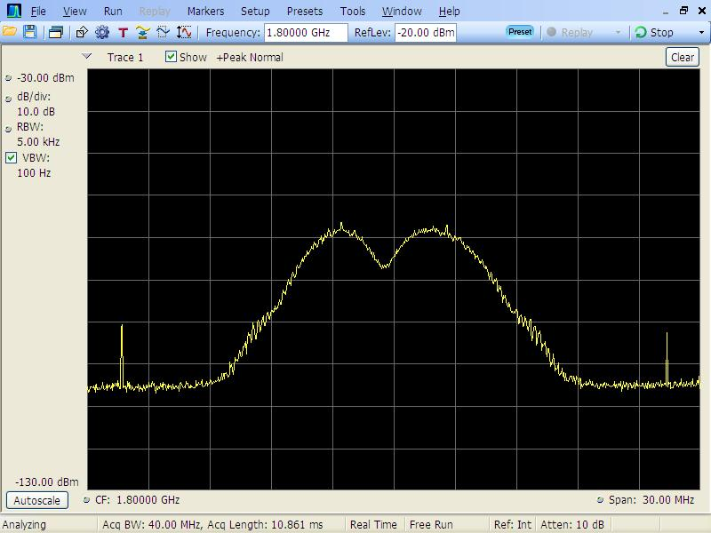
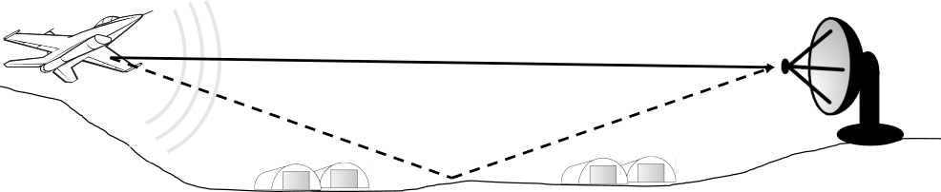
Multipath

Slide 5
Multipath effects
2 samples/bit
Notes:
IDEAL channel is the Line of Sight (LOS)
Channel est at 2 samples/bit
These echoes shape the frequency response to produce frequency selective fading

Slide 6
Equalizer Combating Multipath
2 samples/bit
Notes:
An equalizer is also frequency selective and inverts the channel

Slide 7
Problem Statement
Test Ranges need the best aeronautical telemetry link possible
Multipath is one of the dominant causes for link loss in aeronautical telemetry
Blind Constant Modulus Algorithm (CMA) equalizers are currently being used on CPM signals, specifically SOQPSK-TG

Slide 8
Question Blind vs. Data-aided
How much better can data-aided equalizers combat multipath than blind equalizers?
Is it worth increasing the bit rate and spectrum to insert a preamble?

Slide 9
iNet Telemetry Packet Structure
preamble
ASM
data
preamble
ASM
one packet
preamble
ASM
data

Slide 10
Project Goal
Determine which of 6 equalizers perform best in live tests
Data-aided
Zero Forcing
Minimum Mean Squared Error
Initialized Constant Modulus Algorithm
Frequency Domain Equalizer 1
Frequency Domain Equalizer 2
Blind
Constant Modulus Algorithm (CMA)
No Equalization

Slide 11
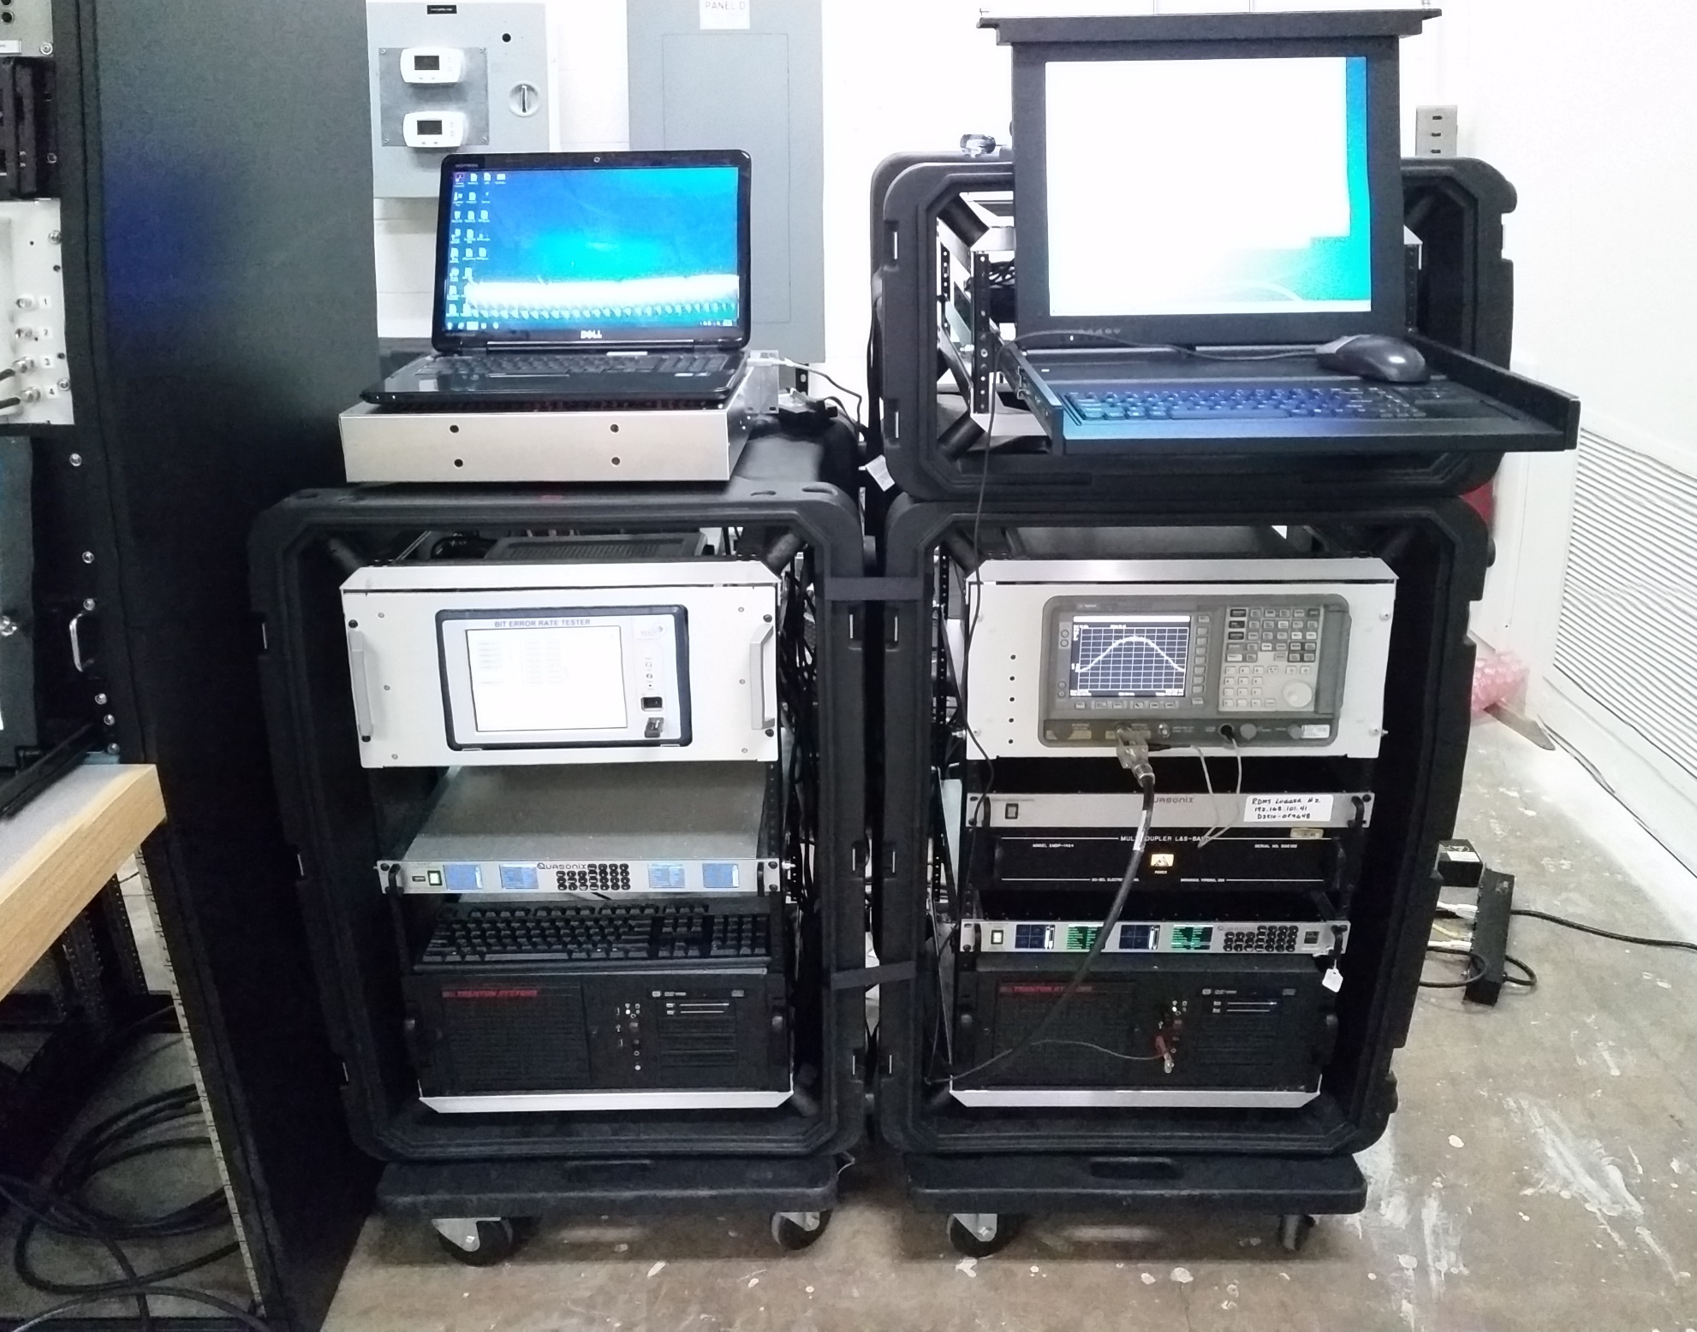

Slide 12
Spectrum analyzer to see multipath
8 channel Bit Error Rate Tester (BERT)
modified receiver to provide I Q samples
blind
equalizer
in off-the-shelf receiver
data-aided equalizers
in GPUs

Slide 13
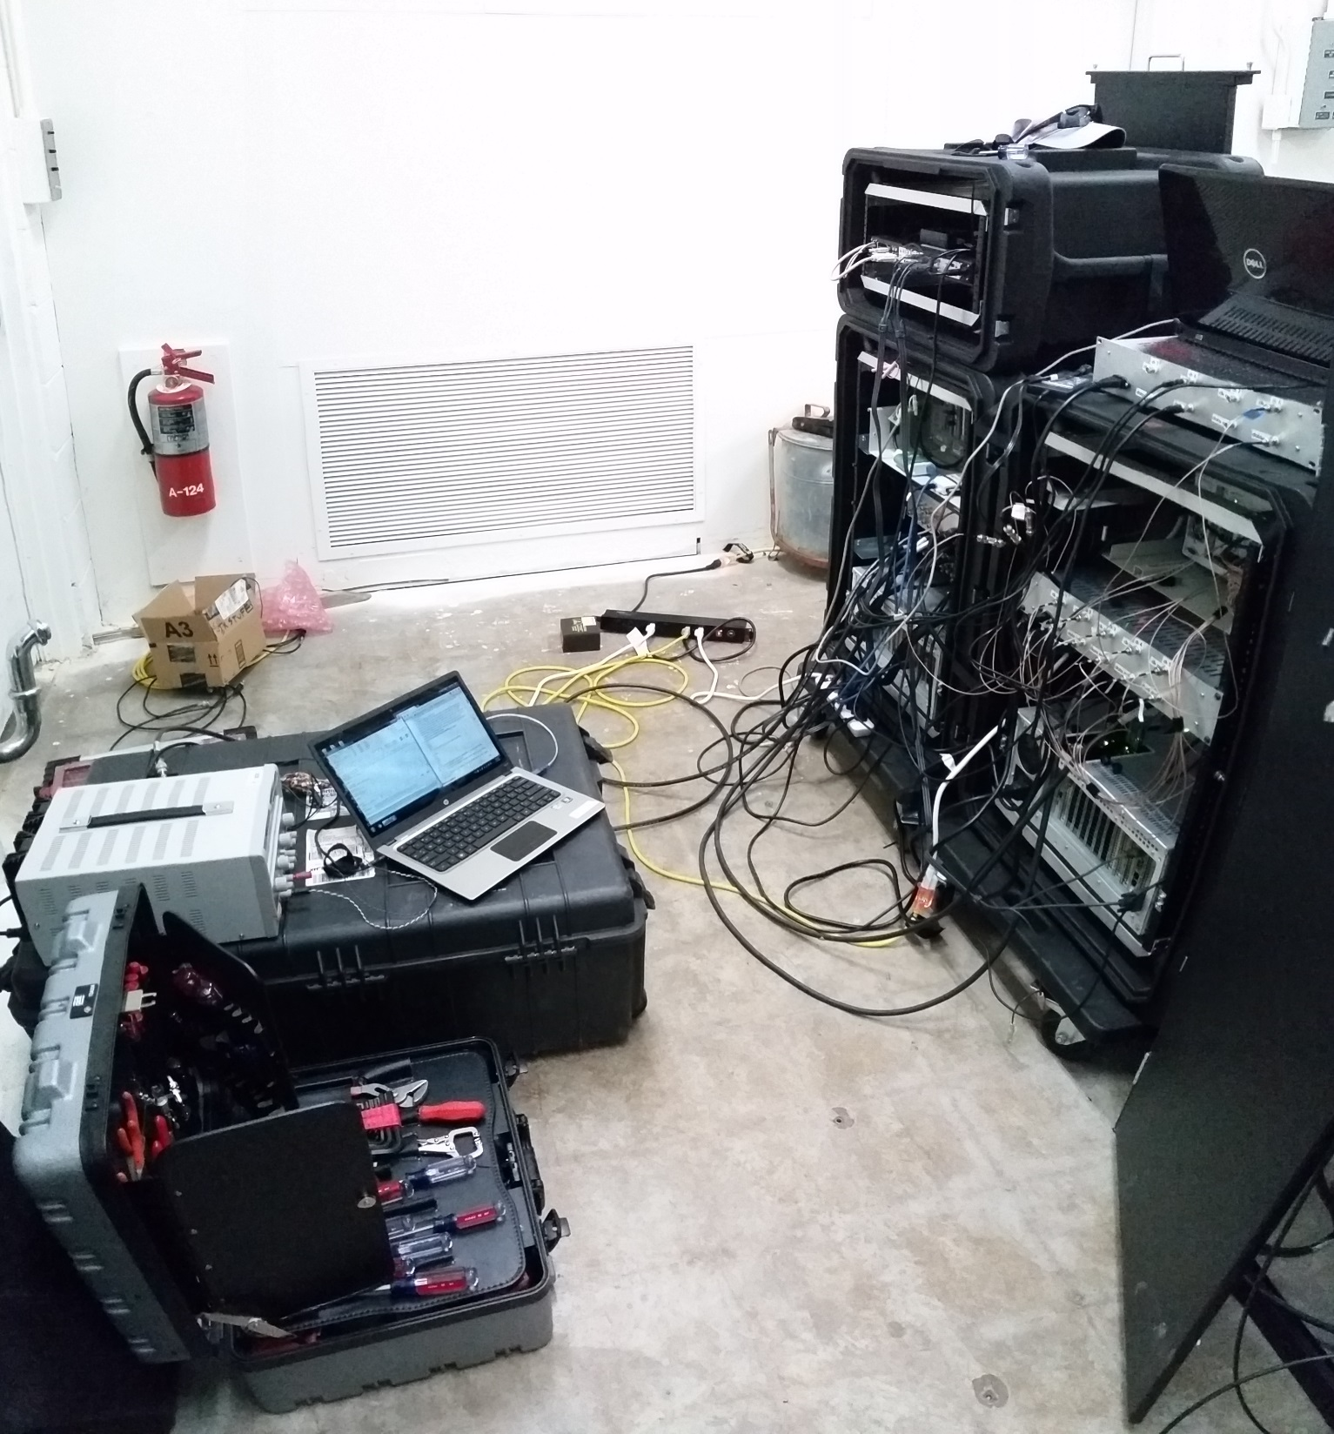

Slide 14
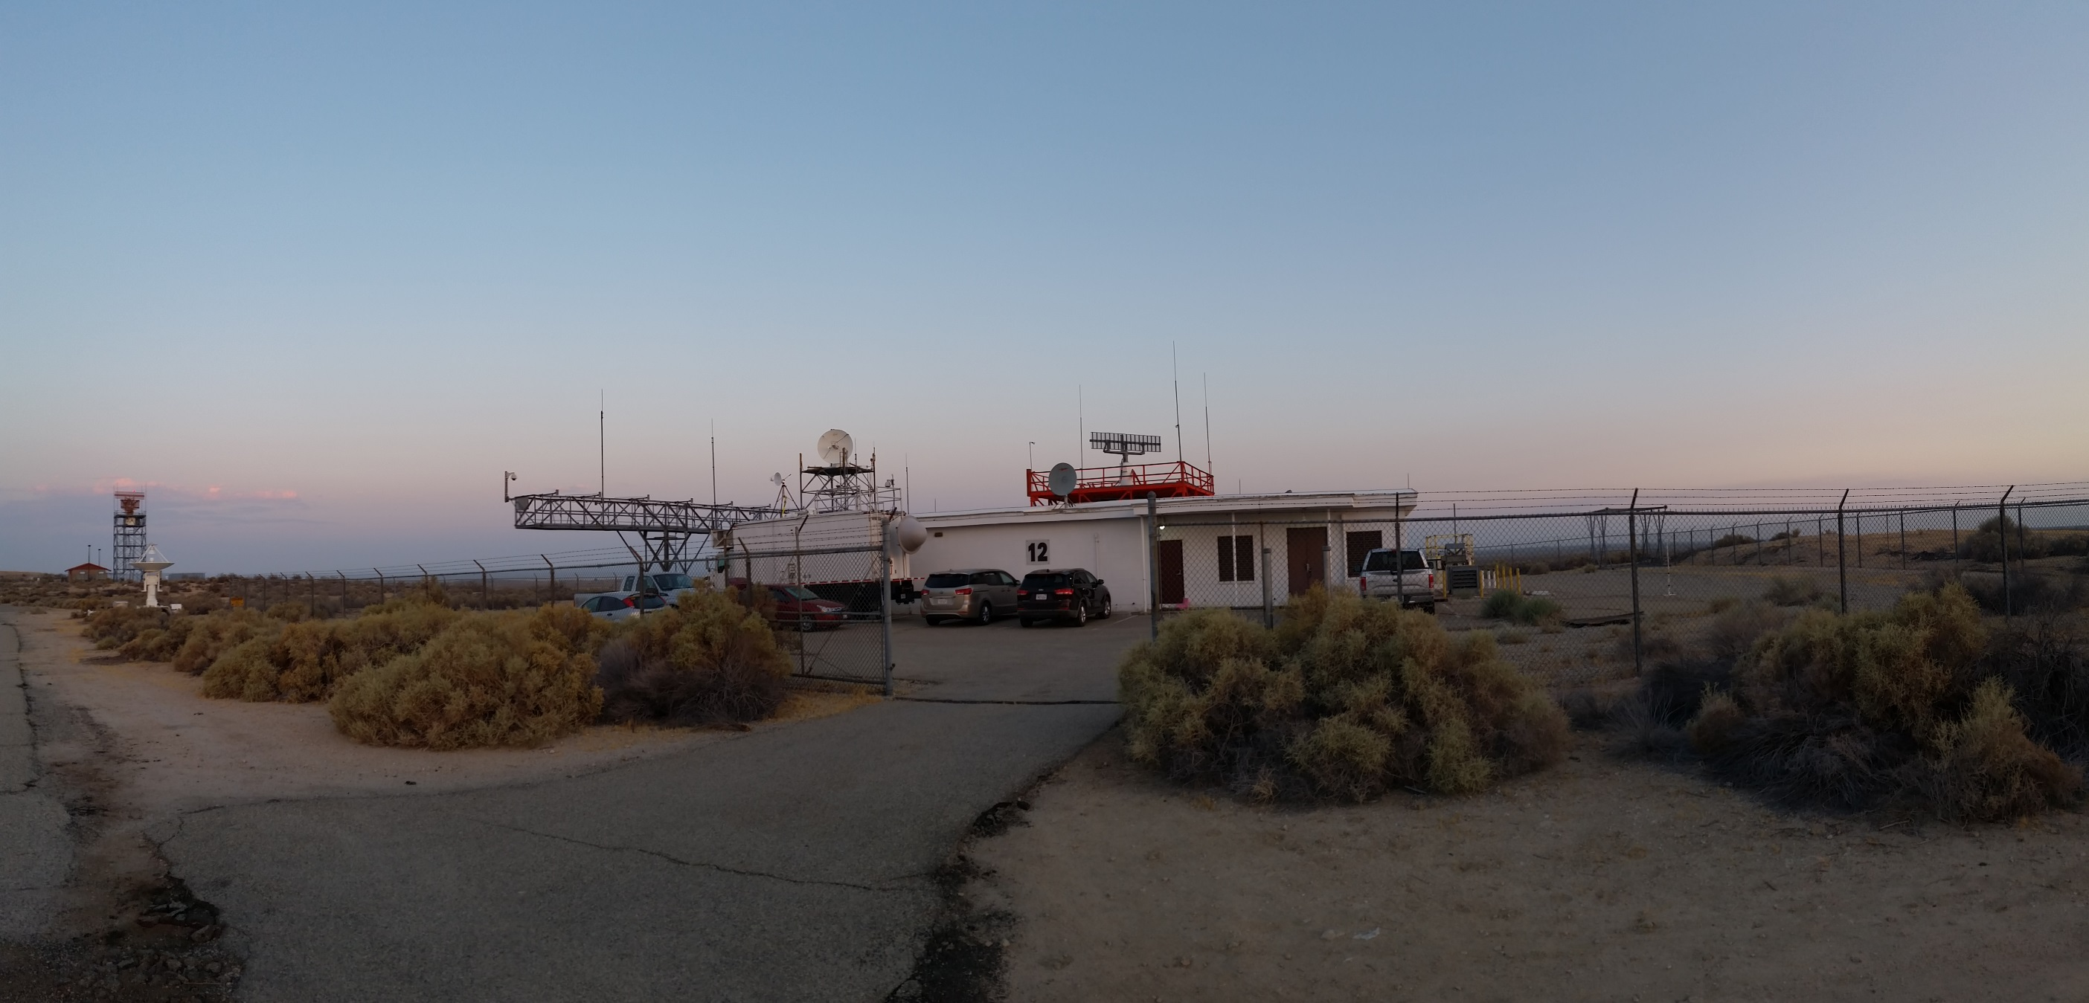

Slide 15
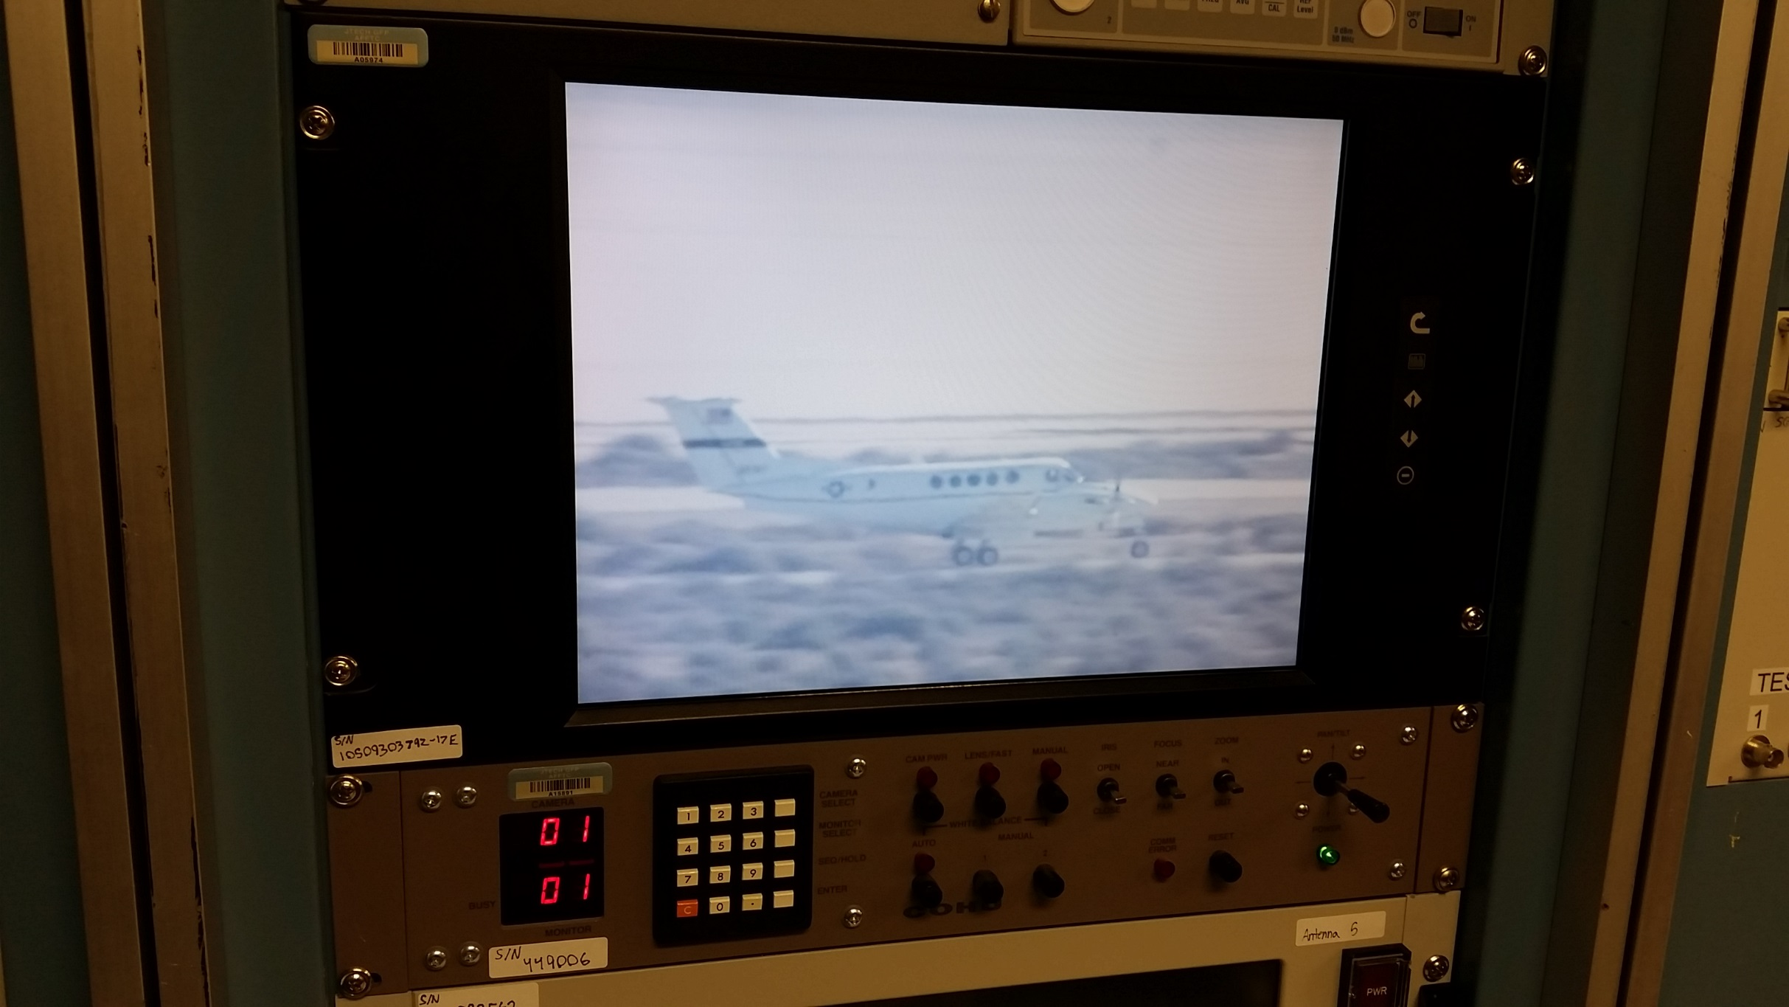

Slide 16
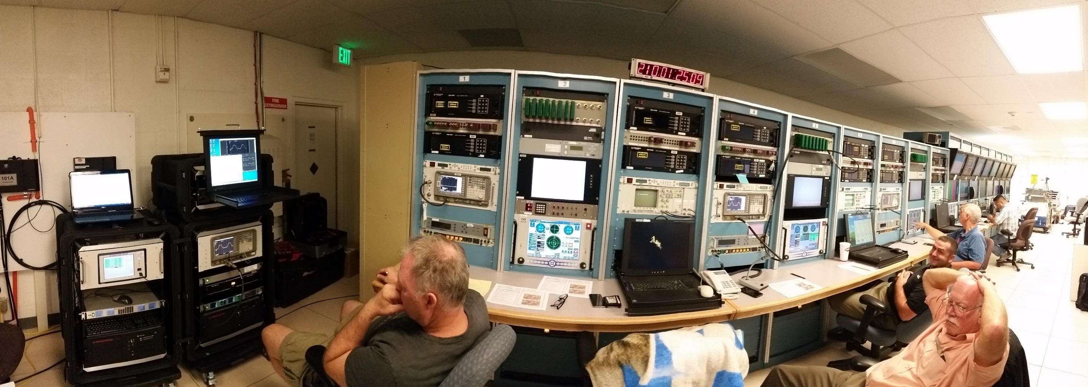

Slide 17
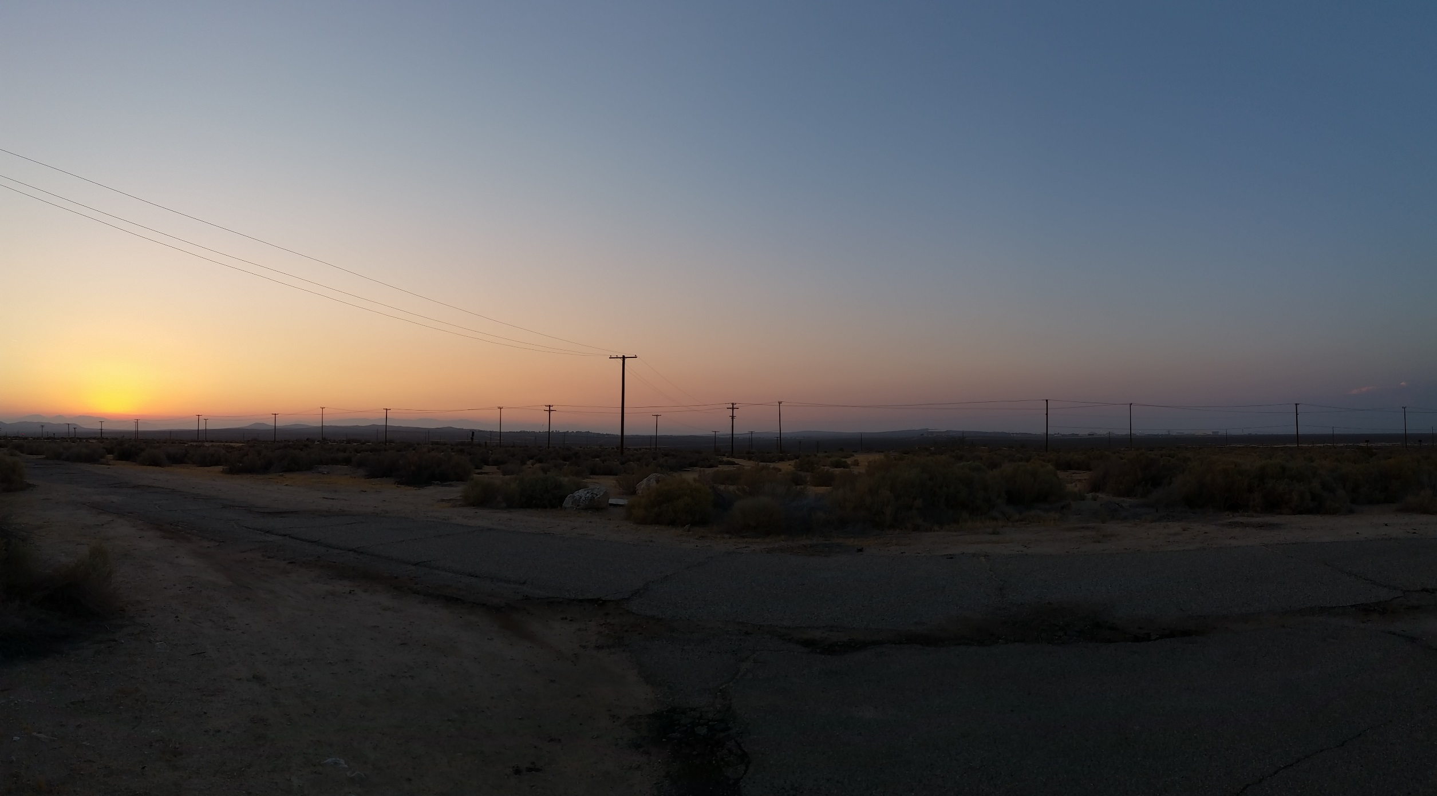

Slide 18
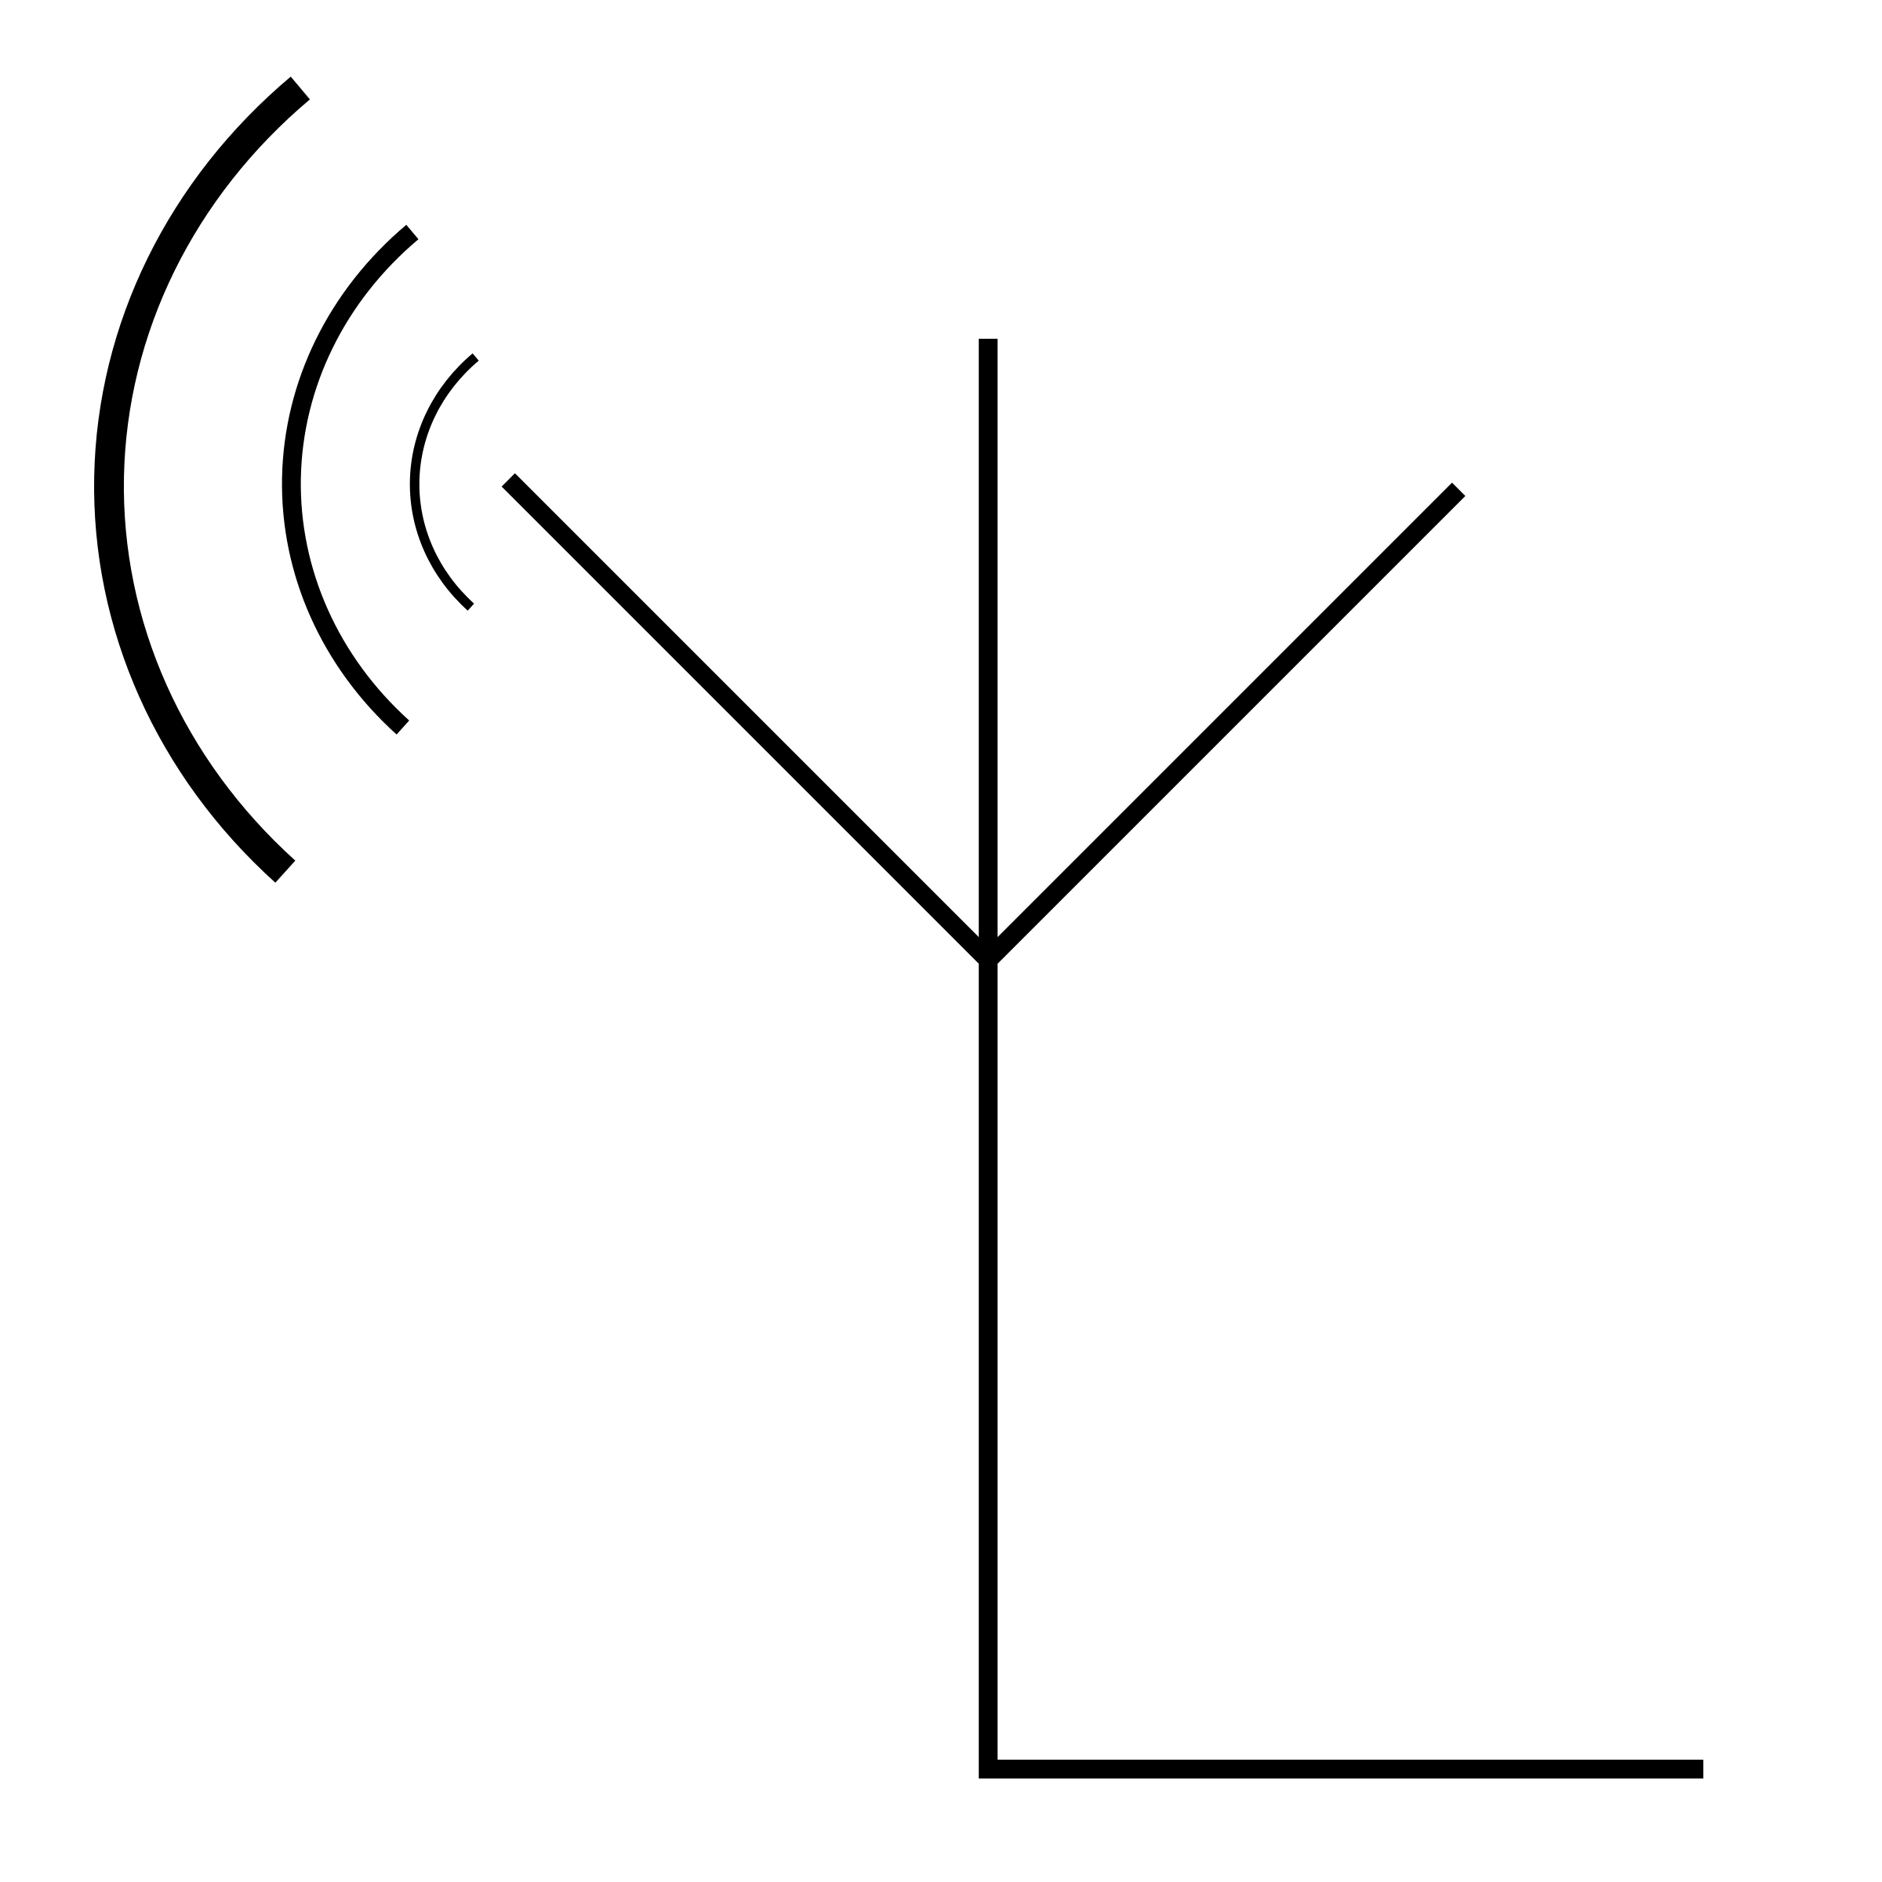
AGC voltage (20 dB/V, 0.1 ms time constant)
DAQ
NI USB 6008
(10 samples/s)
ribbon cable
(I/Q samples @ 2 samples/bit, 12 bits/sample)
PCIe bus
PCIe bus
multicoupler
modified
telemetry receiver
FPGA
interface
circuit
host
computer
GPU
Nvidia K40
QSX-RDMS-RM2-Q-1100-X2
GPU
Nvidia K20
FPGA
interface
circuit
to BERT
channels 1-5
GPU
Nvidia K20
multicoupler
Xlinx FMC XM105
Xlinx ARTIX-7 FPGA AC701
ZF
BERT
ch 1
clock/data
MMSE
ch 2
from FPGA interface circuit
ICMA
ch 3
FDE1
ch 4
telemetry receiver
FDE2
ch 5
preamble
detector
(FPGA)
ch 6
ch 7
QSX-RDMS-RM2-Q-1100-X2
ch 8
telemetry receiver w/EQ
preamble
detector
(FPGA)
Reach Technologies BERT-50S-8
spectrum analyzer
QSX-RDMS-3R1D-A1-1111-00-14-EQ-K7
to antenna tracking receivers
Mu-Del 2MDP-22400
Agilent E4407 B

Slide 19
AGC voltage (20 dB/V, 0.1 ms time constant)
DAQ
NI USB 6008
(10 samples/s)
ribbon cable
(I/Q samples @ 2 samples/bit, 12 bits/sample)
PCIe bus
PCIe bus
multicoupler
modified
telemetry receiver
FPGA
interface
circuit
host
computer
GPU
Nvidia K40
QSX-RDMS-RM2-Q-1100-X2
GPU
Nvidia K20
FPGA
interface
circuit
to BERT
channels 1-5
GPU
Nvidia K20
multicoupler
Xlinx FMC XM105
Xlinx ARTIX-7 FPGA AC701
ZF
BERT
ch 1
clock/data
MMSE
ch 2
from FPGA interface circuit
ICMA
ch 3
FDE1
ch 4
telemetry receiver
FDE2
ch 5
preamble
detector
(FPGA)
ch 6
ch 7
QSX-RDMS-RM2-Q-1100-X2
ch 8
telemetry receiver w/EQ
preamble
detector
(FPGA)
Reach Technologies BERT-50S-8
spectrum analyzer
QSX-RDMS-3R1D-A1-1111-00-14-EQ-K7
to antenna tracking receivers
Mu-Del 2MDP-22400
Agilent E4407 B

Slide 20
Important Numbers
To leverage the parallelism of the GPU
Buffer up 1.972 seconds of data
3104 packets in 1.972 seconds
Must do all processing in 1.972 seconds to stay real time

Slide 21

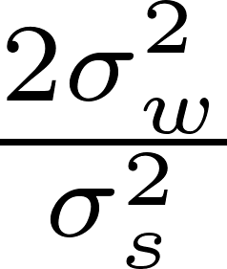
Estimators
Preamble Detector
Frequency Offset Estimator and Compensation
Channel Estimator
Noise Estimator

Slide 22
Equalizers
Data-aided
Zero Forcing (ZF)
Minimum Mean Squared Error (MMSE)
Initialized Constant Modulus Algorithm (CMA)
Frequency Domain Equalizers (FDE1 & FDE2)
Blind
Constant Modulus Algorithm (CMA)
No Equalizer

Slide 23
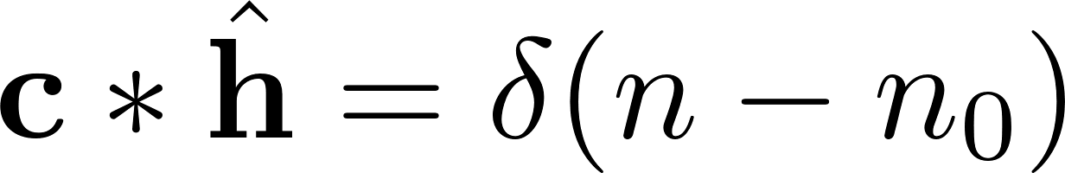
The Point of Equalizers
Invert the channel
Cancel echoes
For CPM signals, push samples back to unit circle
To compute an equalizer, we need to do de-convolution

Slide 24
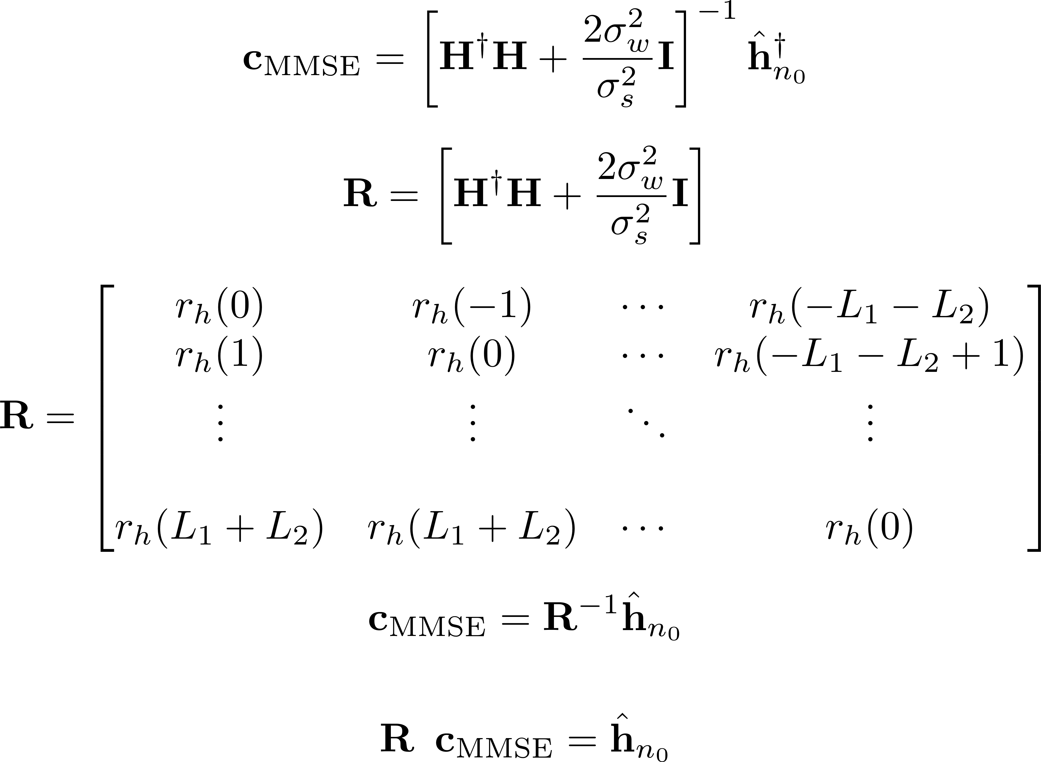
MMSE Equalizer

Slide 25
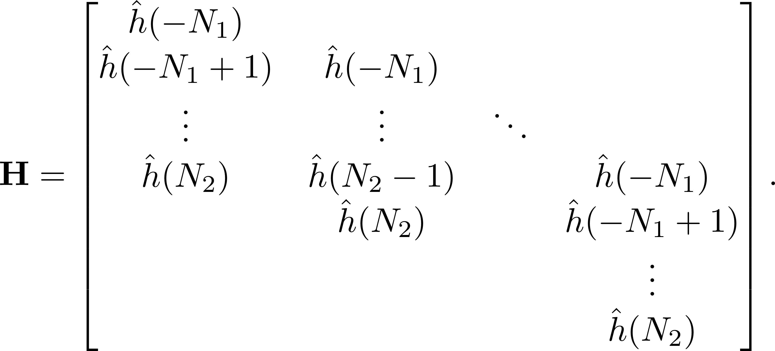
MMSE Equalizer
186x186 SPARSE matrix!!!
186x1 SPARSE vector!!!
186x1 equalizer

Slide 26
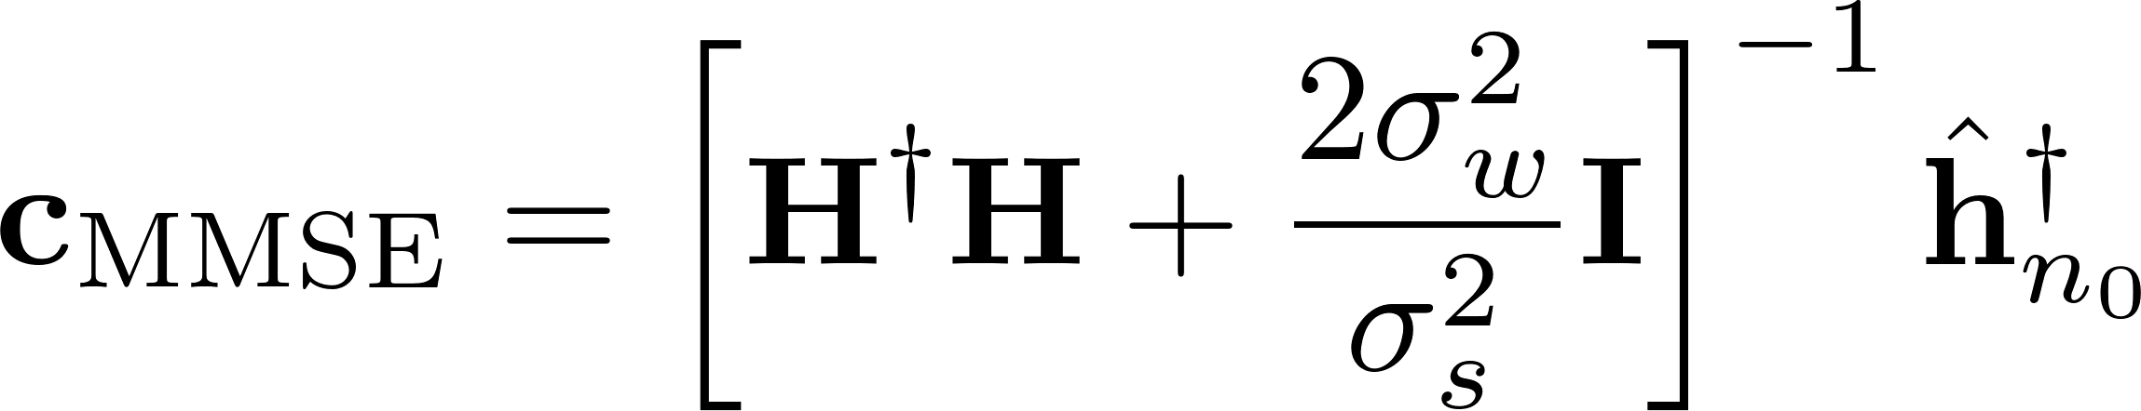
MMSE Equalizer Solution?
Matrix inversion then multiply <3104ms

Slide 27
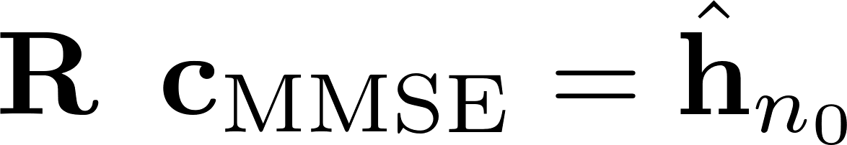
MMSE Equalizer Solution?
Matrix inversion then multiply <3104ms
Levinson-Durbin recursion solver 2500ms
Hermitian and toeplitz

Slide 28
MMSE Equalizer Solution?
Matrix inversion then multiply <3104ms
Levinson-Durbin recursion solver 2500ms
Nvidia’s ninja optimized cusolverSpCcsrqrsvBatched 410ms

Slide 29
MMSE Equalizer Solution?
Matrix inversion then multiply <3104ms
Levinson-Durbin recursion solver 2500ms
Nvidia’s ninja optimized cusolverSpCcsrqrsvBatched 410ms

Slide 30
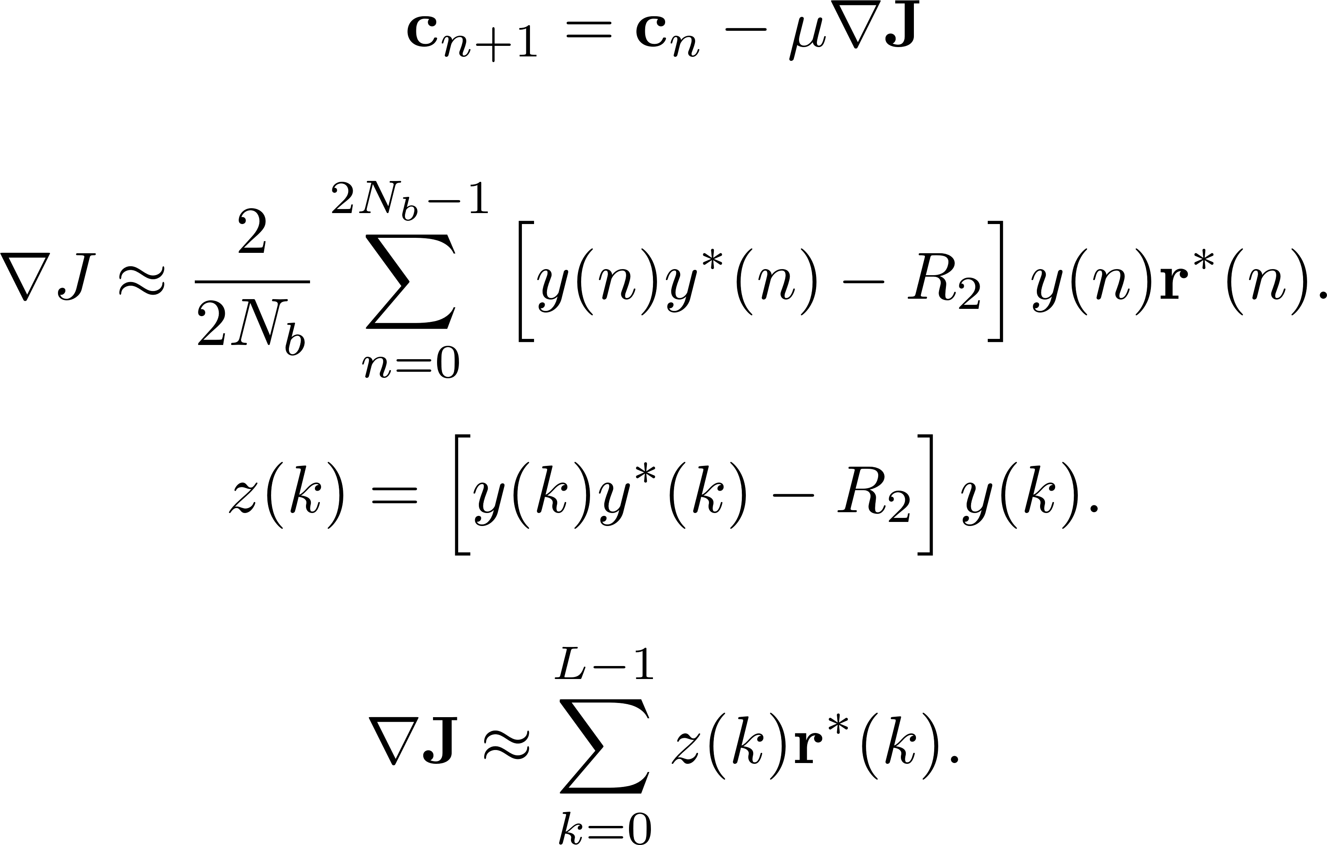
CMA Equalizer

Slide 31
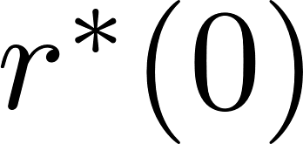
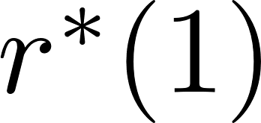
CMA Equalizer Solution?
Implement using a convolution matrix
Matrix will full GPU memory 10x

Slide 32

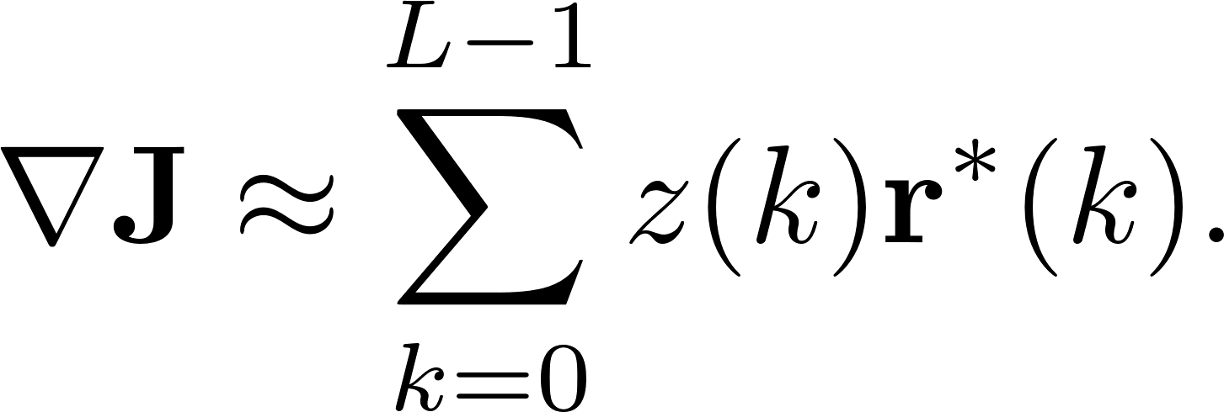
CMA Equalizer Solution?
Implement using a convolution matrix
Matrix will full GPU memory 10x
Compute directly
<160ms giving 6 iterations

Slide 33
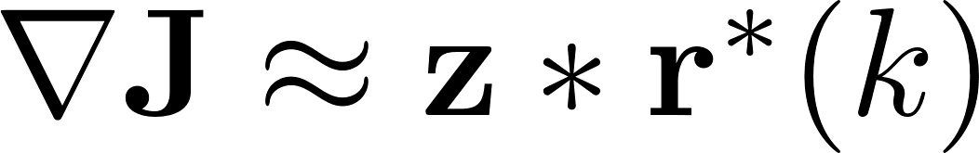
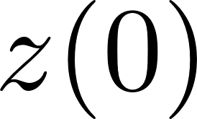
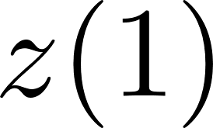
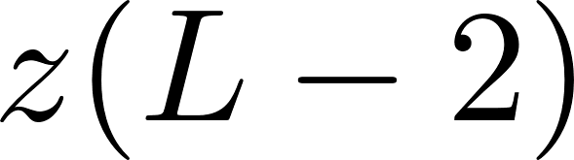
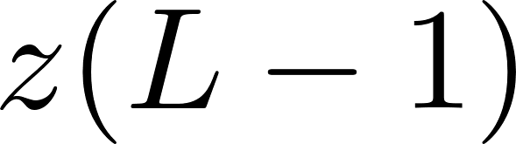
CMA Equalizer Solution?
Implement using a convolution matrix
Matrix will full GPU memory 10x
Compute directly
<160ms giving 6 iterations
Reform to look like a convolution
80ms giving 12 iterations
Morgan State Paper at ITC

Slide 34
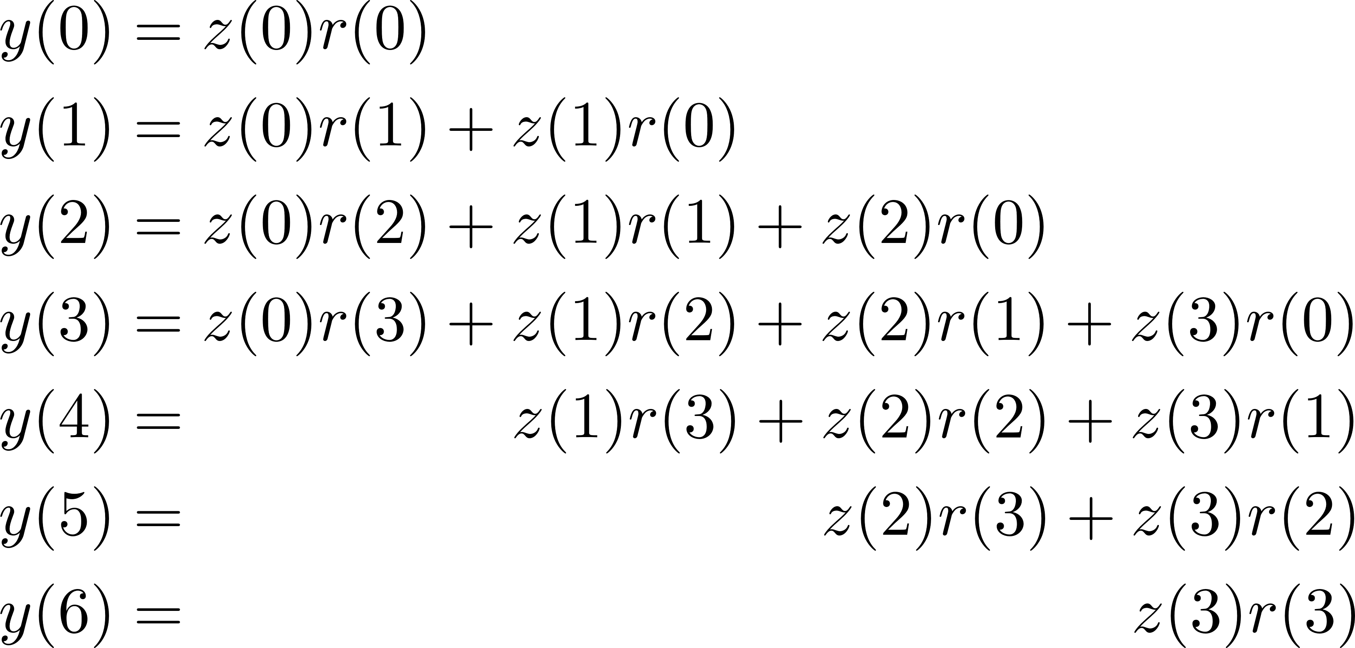
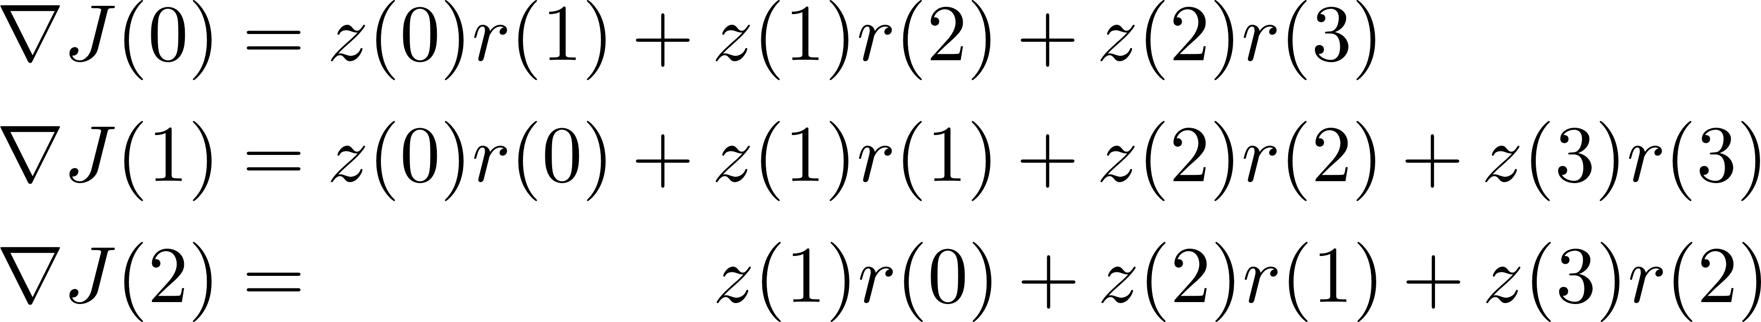
Massaging Convolution
small toy convolution

Slide 35
Massaging Convolution
small toy convolution

Slide 36
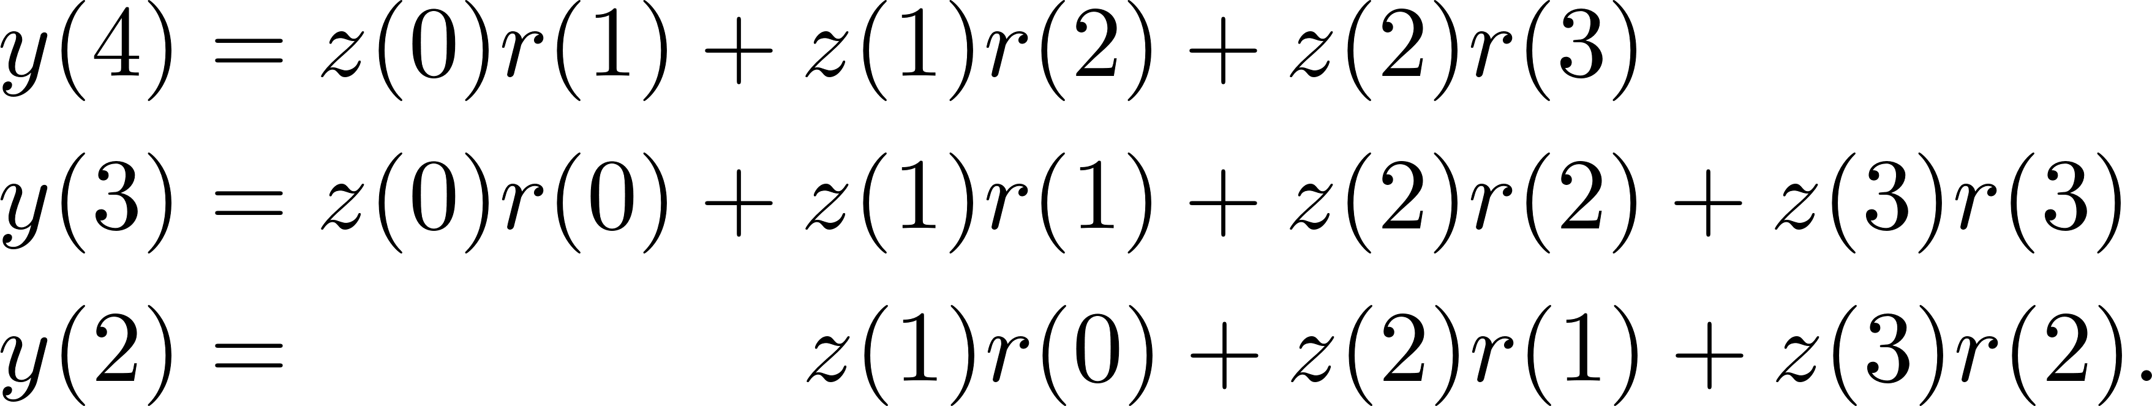
Massaging Convolution
small toy convolution
Reverse one input and the output

Slide 37

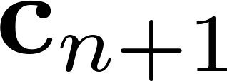

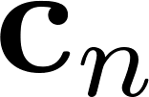

CMA using convolution
reverse
convolution
reverse
update
coeff

Slide 38
Key Contributions
Finished a project that was ~%30 done
Overcame major obstacle that had others stuck for months (slover)
ZF
MMSE
Reformulated iterative algorithm to speed up computation
CMA

Slide 39
Results?

Slide 40
Results?

Slide 41
Results?
Mixed bag…
Strange…
Found emulated channels that the blind equalizers beat data-aided by 10dB…that’s not right
Something is wrong

Slide 42
Cause for Strange Results
The $140,000 Quasonix Receiver gives garbage samples during major multipath events
Root cause is the receiver has a timing loop for optimum sampling
What happens when there is distortion and no perfect sampling point?
Major sample jitter!

Slide 43
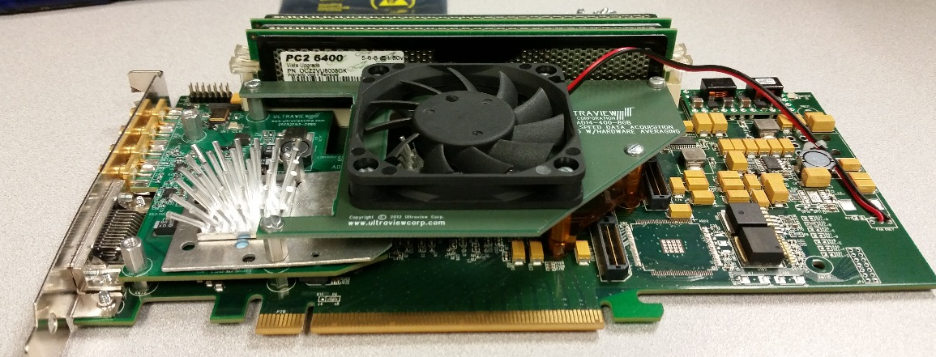
Solution - Current Work
$4500 DAQ PCIe card
Sample 70MHz analog signal at 93 1/3MHz
Polyphase filter resampling 99/244
No timing loop, no garbage samples

Slide 44
Questions?

